Slide 1
VIP Website 7.0 Team Member(s): Steve Hirabayashi, Andres Moser, Leon Liang, Adam Levy, and Dale Keith Product Owner(s): Francisco Ortega, Masoud Sadjadi Professor: Masoud Sadjadi School of Computing and Information Sciences Florida International University
VIP/Senior Project Final Presentation Fall 2017
December 1, 2017
Notes:
Greet your audience, thank them for attending your presentation, introduce yourself, introduce your project, introduce your team members, and quickly indicate what each of you did in a high-level manner, and put more emphasis on your part/contribution.

Slide 2
Problem definition
Whole Project:
Added semester functionality
Redesigned Admin Panel
Improved UI and access to information
My Part:
Steve: Resdesigned Admin Panel, added support for courses
Andres: Added ability to add/modify semesters
Leon: Improved filters, sorting, and searching, added support for previous projects
Adam: Activated support for Mobile Judge integration
Dale: Added support for additional videos and documents on projects, improved UI and added information to project cards
Notes:
Introduce the problem that the whole project tackles and stay focused on the parts that you have been working. Indicate if there is an existing previous system, enumerate its problems/limitations, etc.

Slide 3
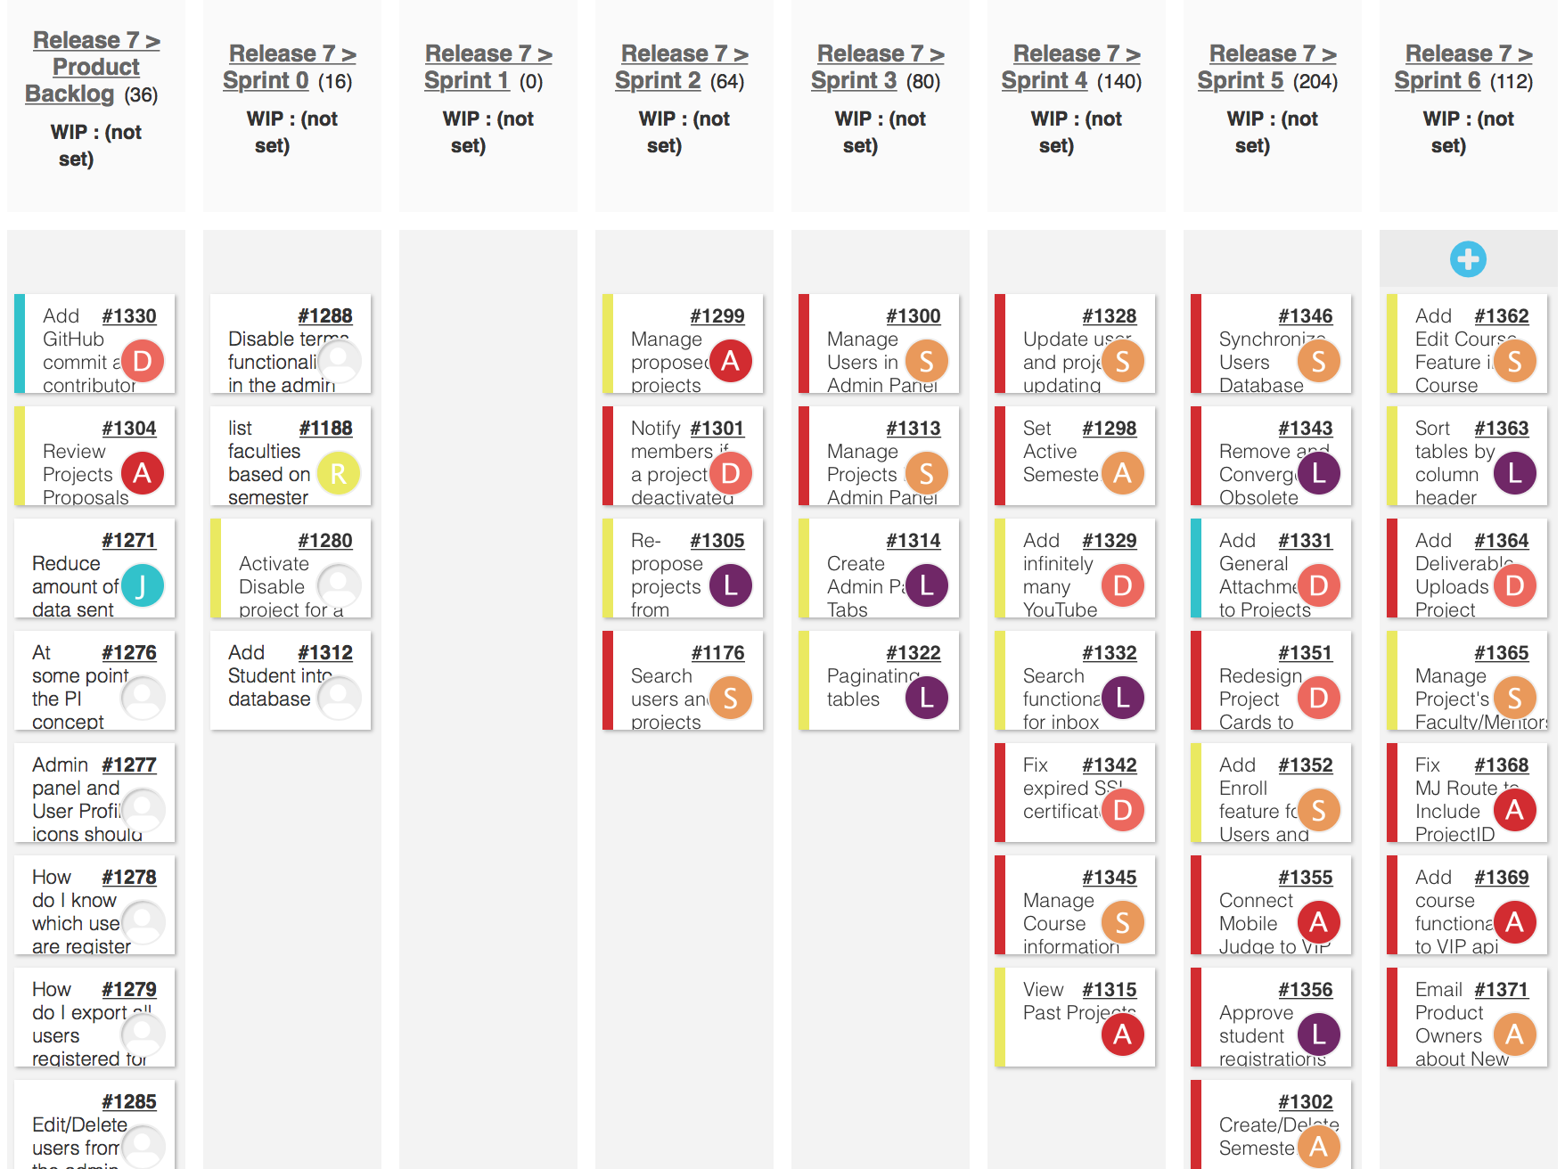
Project Management
Notes:
Project Management (schedule for entire semester) (one slide; Gantt Chart).

Slide 4
Key User Stories
Add an unlimited number of YouTube videos to a project.
Mobile Judge Integration
Create/Delete Semester
Redesign Admin Panel – Projects/Users
Create Admin Panel Tabs
Manage Course information
Notes:
4. Requirements:
4.1. User stories implemented (one or more slides).
4.2. UML use cases and the use case diagram for the implemented use cases (one or more slides).
4.3. UML sequence diagrams for the implemented use cases.

Slide 5
Add an unlimited number of YouTube videos to a project.
Description
As a user, I want to be able to add as many YouTube videos to a project as possible, exceeding the three video maximum that currently exists.
Acceptance Criteria
The videos should be displayed in as a gallery on the page.
Fix the YouTube playlist field, as it does not currently have any functionality implemented
Add the number of YouTube videos to the project’s card

Slide 6
Mobile Judge Integration
Description
The Mobile Judge application currently uses the API from the old senior project website project. Reconfigure VIP website API so that Mobile Judge can make requests and receive information from the VIP website API.
Acceptance Criteria
The Mobile Judge application will can make its requests from the VIP Website API.
The Mobile Judge application will function as it did when making its requests to the SPWS API.

Slide 7
Create/Delete Semester
Description
As an Pi/CoPi I would like to be able to add a new semester with relevant information in the Semester Maintenance Panel.
Acceptance Criteria
Ability to choose Start/End Date (MM/DD/YYYY)
Admin can set name to what they deem appropriate (input is a string)
Admin can set properties for new Semester(Current, Viewable, Applicable, Proposable)

Slide 8
Redesign Admin Panel - Projects
Description
As a PI/CoPI, I would like to be able to make changes to a project’s properties, so that I can easily modify/update the information of projects.
Acceptance Criteria
After selecting the option to change the project’s properties and entering the new properties for the project, the project’s updated information will be displayed to the user.
Need to add ability to change the semester of projects so that PI/CoPI can move pending and proposed projects to a better time frame.
Merge the Admin Panel UI for searching and filtering with the ability to modify the project’s properties.

Slide 9
Redesign Admin Panel - Users
Description
As a PI/CoPI, I would like to be able to make changes to a user’s properties, so that I can easily modify/update the information of users.
Acceptance Criteria
After selecting the option to change the user’s properties and entering the new properties for the project, the user’s updated information will be displayed to the user.
Need to add ability to change the semester of user’s so that PI/CoPI can move users to future semesters.
Merge the Admin Panel UI for searching and filtering with the ability to modify the user’s properties.

Slide 10
Create Admin Panel Tabs
Description
As a PI/Co-PI, I want to be able to navigate to different admin functionality through tabs so that I would not have to manually scroll down to the bottom in order to access functionality.
Acceptance Criteria
The tabs should directly take user to functionality corresponding to the tab in one click
Tabs should contain all functionality from before
Admin panel should be reduced in size and have the drop down functionalities removed

Slide 11
Manage Course information
Description
As a PI/CoPI, I would like to be able to view, add, and remove a course, so that I can easily modify/update the information of current courses and users that are currently in a course.
Acceptance Criteria
After selecting the option to add/remove a course, PI/CoPi will be able to see the addition/removal of the course. If a user is associated with that course, that user is also updated in the system.
After selecting the option to change the user’s properties and changing the course of that user, the user’s updated course information will be displayed to the PI/CoPI.
Need to have ability to filter users by their course.

Slide 12
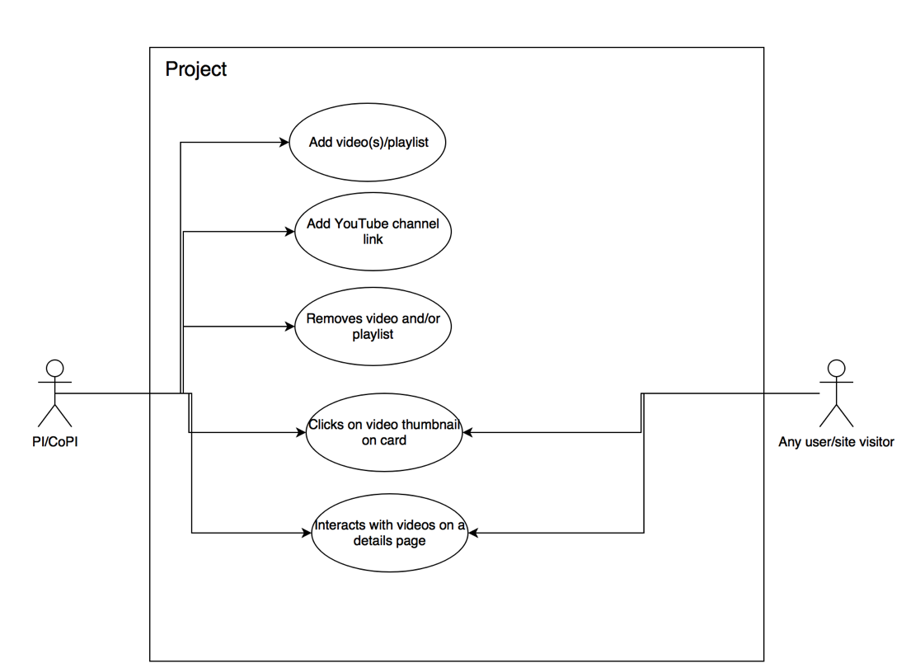
Use Case Diagram
Use Case Diagram for the Add Video User Story with five separate use cases.
Notes:
4. Requirements:
4.1. User stories implemented (one or more slides).
4.2. UML use cases and the use case diagram for the implemented use cases (one or more slides).
4.3. UML sequence diagrams for the implemented use cases.

Slide 13
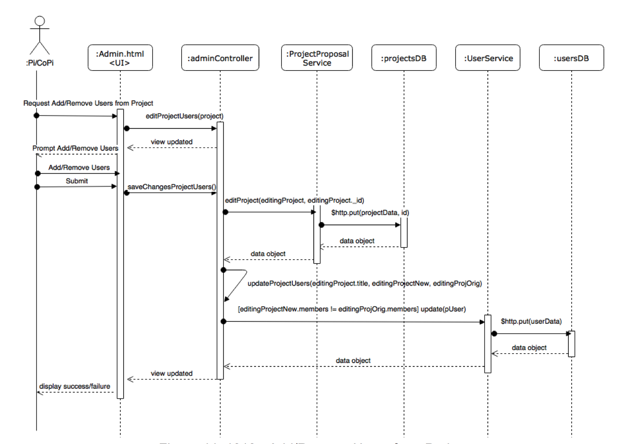
Sequence Diagram for Adding Users
Shows the Admin Panel and uses all areas of the website.
Notes:
4. Requirements:
4.1. User stories implemented (one or more slides).
4.2. UML use cases and the use case diagram for the implemented use cases (one or more slides).
4.3. UML sequence diagrams for the implemented use cases.

Slide 14
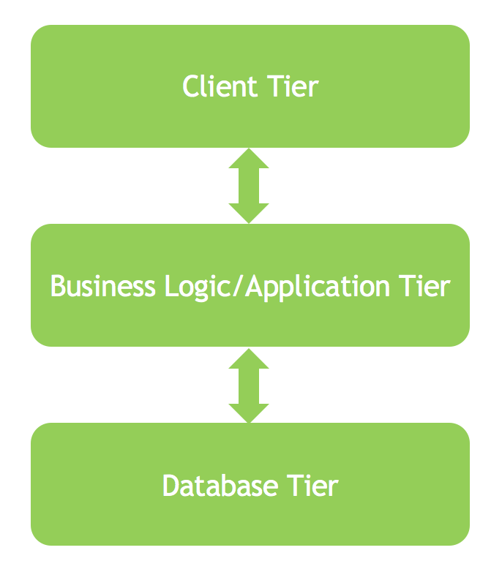
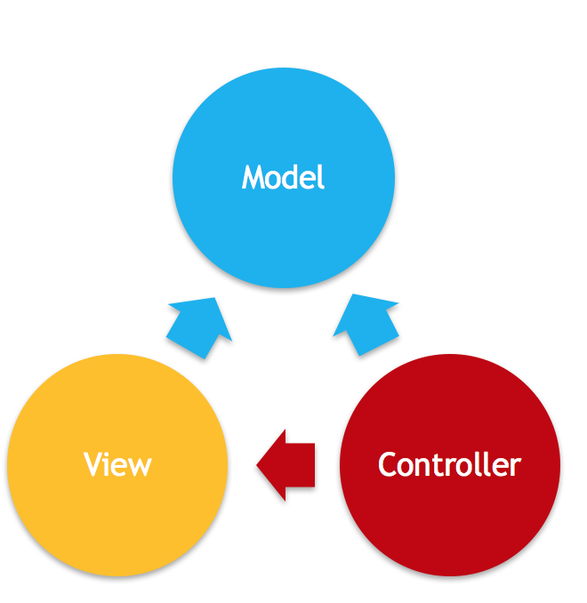
System Design: Architecture
3-tiered architecture
Model-View-Controller
Notes:
5. System design:
5.1. System decomposition; identify the architecture patterns used (one slide).
5.2. System deployment – h/w and s/w requirements (one slide).
5.3. Persistent data design (one slide).
5.4. Security/Privacy (one slide).

Slide 15
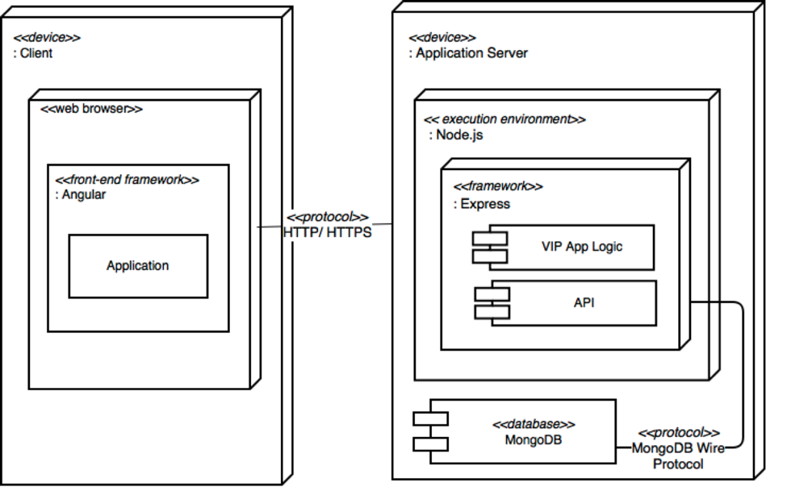
System Design: Deployment
Notes:
5. System design:
5.1. System decomposition; identify the architecture patterns used (one slide).
5.2. System deployment – h/w and s/w requirements (one slide).
5.3. Persistent data design (one slide).
5.4. Security/Privacy (one slide).

Slide 16
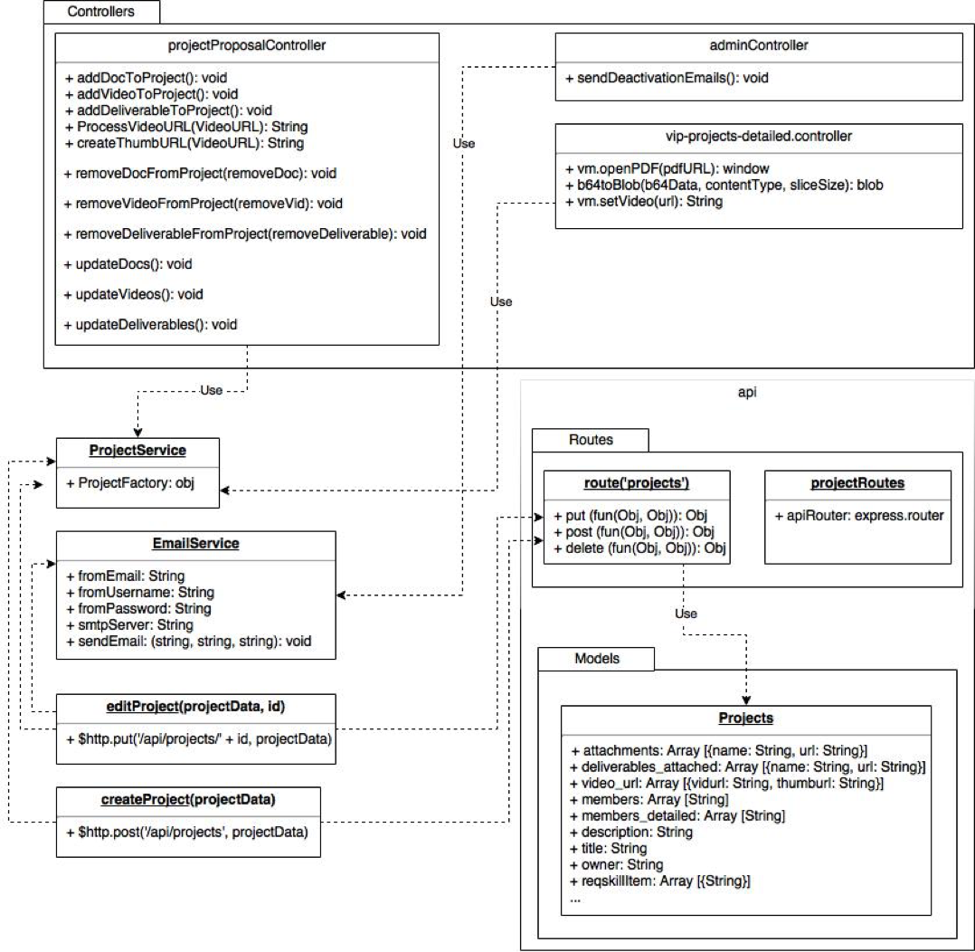
Minimal Class Diagram
Notes:
6. Detailed design:
6.1. Minimal class diagram. Identify the design patterns used (one or more slides).
6.2. State machine for the main control object or the most important object of the implemented uses cases (one or more slides).
6.3. Main algorithm used related to an implemented use case described above (one or more slides).

Slide 17
Sample Test Case - VIP-1313-U2 (Rainy Day)
Description: Admin edits project properties
Summary of Test:
Tester selects ‘edit project properties’ button
Tester modifies project with project data into edit project dialog
Tester selects ‘save changes’ button
Pre-Condition
User with Pi/CoPi privileges has logged into the VIP website
User is at the admin panel page - project maintenance tab
Expected Results
Project will not be updated in the database
Projects panel table will not be updated
Tester will be notified of error
Actual Result:
Project will not be updated in the database
Projects panel table will not be updated
Tester will be notified of error
Status (Fail/Pass): PASS
Notes:
7. Test Suites and Test Cases (one sunny day and one rainy day) for the use case represented in part (5) above (2 slides).
7.1 One sunny day and one rainy day for the implemented use cases (one or more slides).
7.2 Automated test scripts for the implemented use cases (one or more slides).

Slide 18
Sample Test Case - VIP-1313-U3 (Sunny Day)
Description: Admin adds/removes project’s users
Summary of Test:
Tester selects ‘add/remove users’ button
Tester finds and selects user ‘testF’ in add user
Tester selects ‘add user’ button
Tester selects ‘remove user’ button for a user other than ‘testF’
Tester selects ‘save changes’ button
Pre-Condition
User with Pi/CoPi privileges has logged into the VIP website
User is at the admin panel page - project maintenance tab
Project selected already has users assigned to it as current members
Test VIP-1300-U1 has been executed
Expected Results
Project will be updated in the database
Projects panel table will be updated
Users will be updated in the database
Users panel table will be updated
Tester will be notified of success
Actual Result:
Project will be updated in the database
Projects panel table will be updated
Users will be updated in the database
Users panel table will be updated
Tester will be notified of success
Status (Fail/Pass): PASS
Notes:
7. Test Suites and Test Cases (one sunny day and one rainy day) for the use case represented in part (5) above (2 slides).
7.1 One sunny day and one rainy day for the implemented use cases (one or more slides).
7.2 Automated test scripts for the implemented use cases (one or more slides).

Slide 19





Summary
Steve Hirabayashi - shira002@fiu.edu
Dale Keith – dkeit008@fiu.edu
Adam Levy- alevy030@fiu.edu
Andres Moser - amose001@fiu.edu
Leon Liang - llian008@fiu.edu
Questions?
Thank You!
Notes:
Summarize your contribution
Include your contact information
Ask if anyone has any questions for you.
Thank your audience

